Slide 1


Discrete-Time Fourier Transform (DTFT)
Chapter Intended Learning Outcomes:
(i) Understanding the characteristics and properties of DTFT
(ii) Ability to perform discrete-time signal conversion
between the time and frequency domains using DTFT and
inverse DTFT
Y.Chen
Page 1
Semester A, 2022-2023

Slide 2


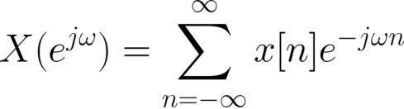

Definition
DTFT is a frequency analysis tool for aperiodic discrete-time
signals
The DTFT of ,
, has been derived in (5.4):
(6.1)
The derivation is based on taking the Fourier transform of
of (5.2)
As in Fourier transform,
is also called spectrum and is
a continuous function of the frequency parameter
Y.Chen
Page 2
Semester A, 2022-2023

Slide 3
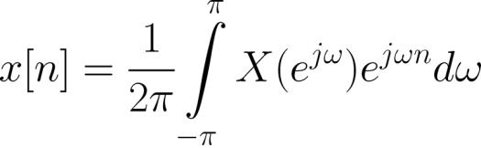
To convert
to , we use inverse DTFT:
(6.2)
Proof: Putting (6.1) into (6.2) and using (4.13)-(4.14):
Y.Chen
Page 3
Semester A, 2022-2023

Slide 4
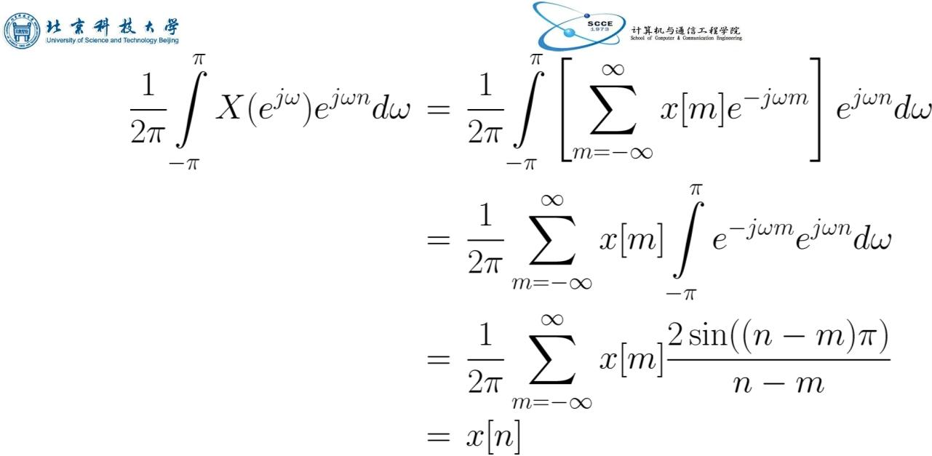
(6.3)
Y.Chen
Page 4
Semester A, 2022-2023

Slide 5
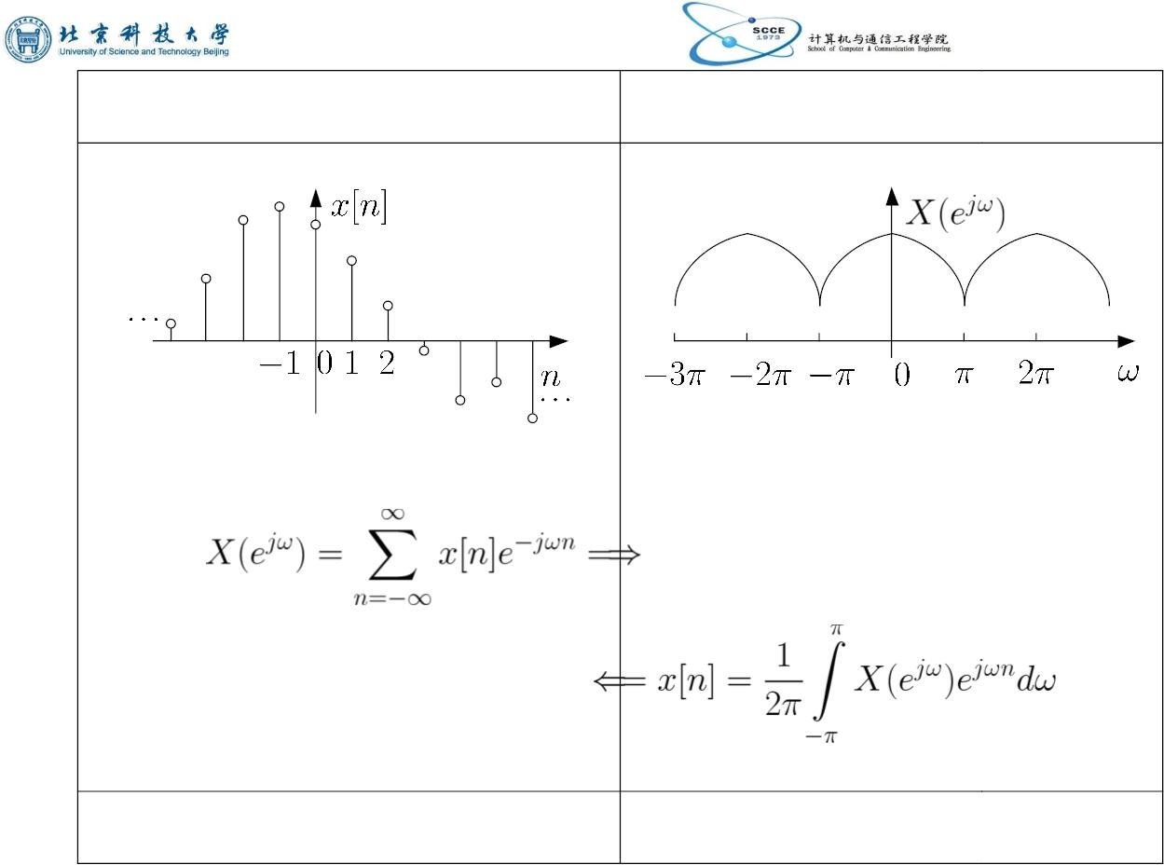
time domain
frequency domain
...
...
discrete and aperiodic
continuous and periodic
Fig.6.1: Illustration of DTFT
Y.Chen
Page 5
Semester A, 2022-2023

Slide 6




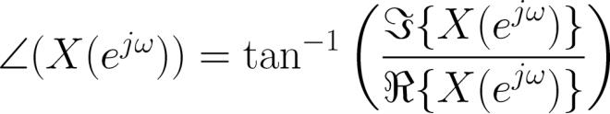
is continuous and periodic with a period of
is generally complex, we can illustrate
using the
:
magnitude and phase spectra, i.e.,
and
(6.4)
(6.5)
and
where both are continuous in frequency and periodic.
Y.Chen
Page 6
Semester A, 2022-2023

Slide 7

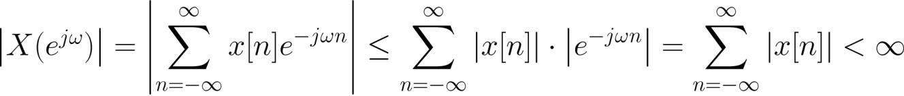


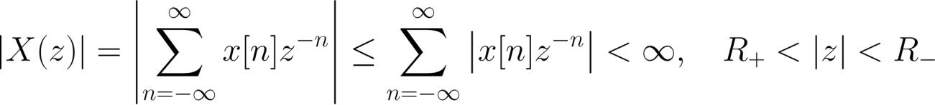
Convergence of DTFT
The DTFT of a sequence
converges if
(6.6)
Recall (5.10) and assume the transform of
for region of convergence (ROC) of
converges
:
(6.7)
When ROC includes the unit circle:
Y.Chen
Page 7
Semester A, 2022-2023

Slide 8
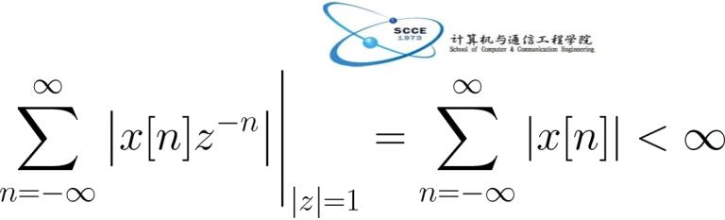





(6.8)
which leads to the convergence condition for
also proves the P2 property of the transform.
. This
Let
be the impulse response of a linear time-invariant
(LTI) system, the following three statements are
equivalent:
S1. ROC for the transform of
S2. The system is stable so that
includes unit circle
S3. The DTFT of , i.e.,
, converges
Y.Chen
Page 8
Semester A, 2022-2023

Slide 9


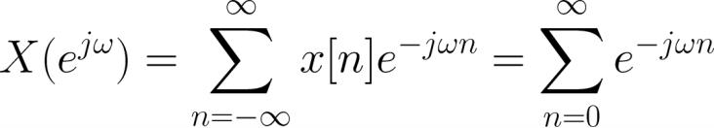
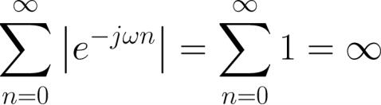
Note that
response
is also known as system frequency
Example 6.1
Determine the DTFT of
.
Using (6.1), the DTFT of
is computed as:
Since
Y.Chen
Page 9
Semester A, 2022-2023

Slide 10
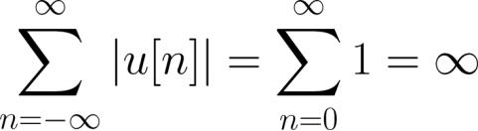


does not exist.
Alternatively, employing the stability condition:
which also indicates that the DTFT does not converge
Furthermore, the transform of
is:
Because
does not include the unit circle, there is no
DTFT for .
Y.Chen
Page 10
Semester A, 2022-2023

Slide 11



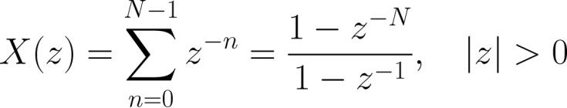
Example 6.2
Find the DTFT of
. Plot the magnitude and
phase spectra for
.
Using (6.1), we have
Alternatively, we can first use transform because
The transform of
is evaluated as
Y.Chen
Page 11
Semester A, 2022-2023

Slide 12


As the ROC includes the unit circle, its DTFT exists and the
same result is obtained by the substitution of
.
There are two advantages of transform over DTFT:
. transform is a generalization of DTFT and it
encompasses a broader class of signals since DTFT does
not converge for all sequences
. notation convenience of writing instead of .
To plot the magnitude and phase spectra, we express
:
In doing so,
and
can be written in closed-
Y.Chen
Page 12
Semester A, 2022-2023

Slide 13
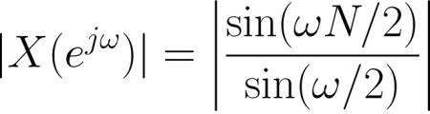
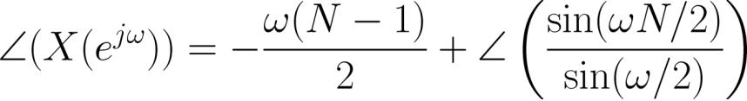
forms as:
and
Note that we generally employ (6.4) and (6.5) for
magnitude and phase computation
In using MATLAB to plot
and
, we utilize the
command sinc so that there is no need to separately
handle the “0/0” cases due to the sine functions
Recall the definition of sinc function:
Y.Chen
Page 13
Semester A, 2022-2023

Slide 14
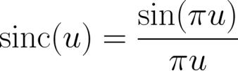
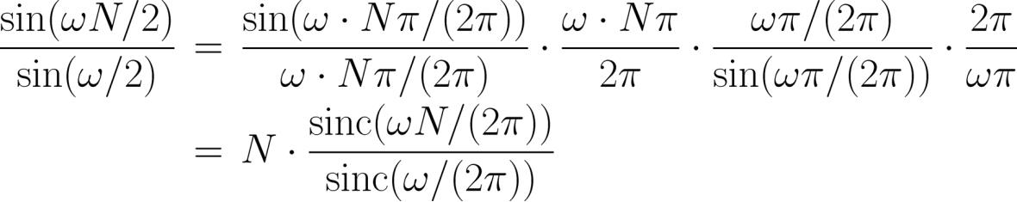
As a result, we have:
Y.Chen
Page 14
Semester A, 2022-2023

Slide 15

The key MATLAB code for
N=10; %N=10
is
w=0:0.01*pi:2*pi; %successive frequency point
%separation is 0.01pi
dtft=N.*sinc(w.*N./2./pi)./(sinc(w./2./pi)).*exp(-
j.*w.*(N-1)./2);
subplot(2,1,1)
Mag=abs(dtft);
plot(w./pi,Mag);
subplot(2,1,2)
Pha=angle(dtft);
plot(w./pi,Pha);
%define DTFT function
%compute magnitude
%plot magnitude
%compute phase
%plot phase
Y.Chen
Page 15
Semester A, 2022-2023

Slide 16


Analogous to Example 4.4, there are 201 uniformly-spaced
points to approximate the continuous functions
and
.
Y.Chen
Page 16
Semester A, 2022-2023

Slide 17
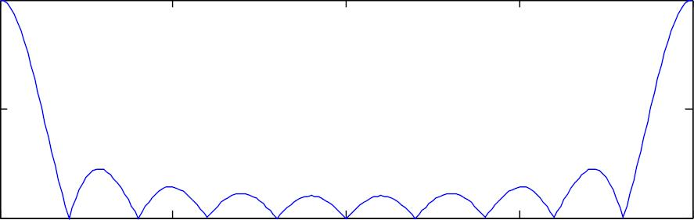
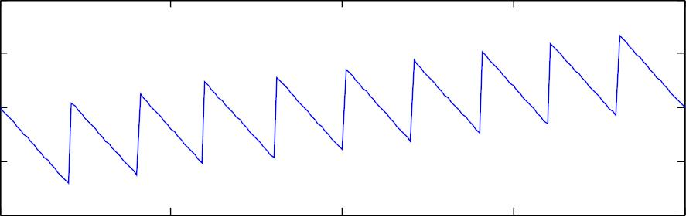
Magnitude Response
10
5
0
0
0.5
1
/
1.5
2
Phase Response
4
2
0
-2
-4
0
0.5
1
1.5
2
/
Fig.6.2: DTFT plots using abs and angle
Y.Chen
Page 17
Semester A, 2022-2023

Slide 18
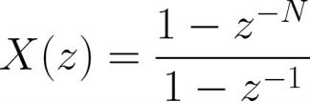


Alternatively, we can use the command freqz:
which is ratio of two polynomials in
The corresponding MATLAB code is:
N=10;
%N=10
a=[1,-1];
%vector for denominator
b=[1,zeros(1,N-1),-1]; %vector for numerator
freqz(b,a) %plot magnitude & phase (dB)
Note that it is also possible to use
and in
this case we have b=ones(N,1)and a=1.
Y.Chen
Page 18
Semester A, 2022-2023

Slide 19
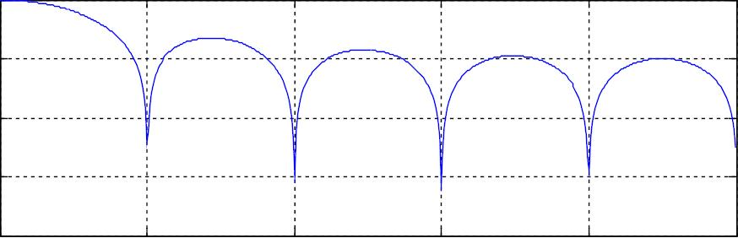
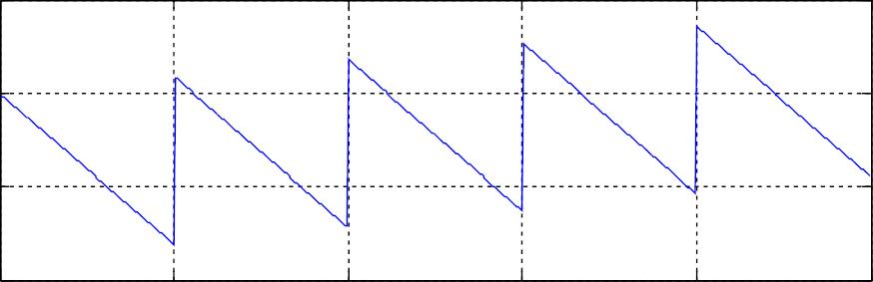
20
0
-20
-40
-60
0
0.2
0.4
0.6
0.8
1
Normalized Frequency ( rad/sample)
100
0
- 100
- 200
0
0.2
0.4
0.6
0.8
1
Normalized Frequency ( rad/sample)
Fig.6.3: DTFT plots using freqz
Page 19
Y.Chen
Semester A, 2022-2023

Slide 20




The results in Figs. 6.2 and 6.3 are identical, although their
presentations are different:
.
at
in Fig. 6.2 while that of Fig. 6.3 is 20
dB. It is easy to verify that 10 corresponds to
dB
. units of phase spectra in Figs. 6.2 and 6.3 are radian and
degree, respectively. To make the phase values in both
plots identical, we also need to take care of the phase
ambiguity.
The MATLAB programs for this example are provided as
ex6_2.m and ex6_2_2.m.
Y.Chen
Page 20
Semester A, 2022-2023

Slide 21

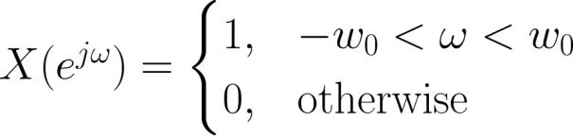

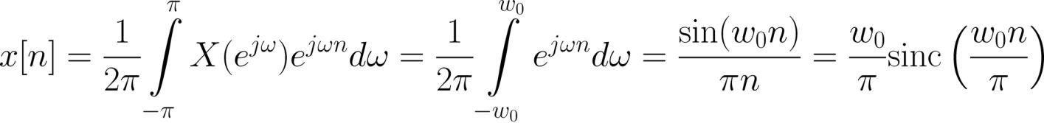
Example 6.3
Find the inverse DTFT of
which is a rectangular pulse
within
:
where
.
Using (6.2), we get:
Y.Chen
Page 21
Semester A, 2022-2023

Slide 22

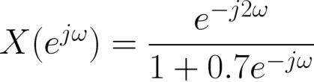

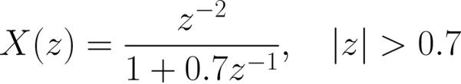
That is,
is an infinite-duration sequence whose values
are drawn from a scaled sinc function.
Example 6.4
Determine the inverse DTFT of
which has the form of:
With the use of
, the corresponding transform is
Note that ROC should include the unit circle as DTFT exists
Y.Chen
Page 22
Semester A, 2022-2023

Slide 23



Employing the time shifting property, we get
Properties of DTFT
Since DTFT is closely related to transform, its properties
follow those of transform. Note that ROC is not involved
because it should include unit circle in order for DTFT exists
1. Linearity
If
and
are two DTFT pairs, then:
(6.9)
2. Time Shifting
Y.Chen
Page 23
Semester A, 2022-2023

Slide 24






A shift of in
causes a multiplication of
in
:
(6.10)
3. Multiplication by an Exponential Sequence
Multiplying by in time domain corresponds to a shift
of in the frequency domain:
(6.11)
which agrees with (5.22) by putting
4. Differentiation
and
Y.Chen
Page 24
Semester A, 2022-2023

Slide 25
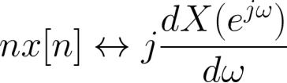
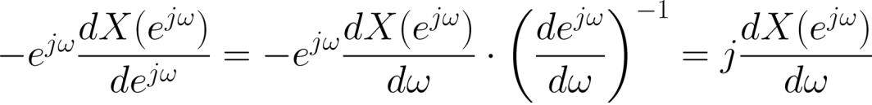


Differentiating
multiplying
with respect to
corresponds to
(6.12)
by :
Note the RHS is obtained from (5.23) by putting
:
(6.13)
5. Conjugation
The DTFT pair for
is given as:
(6.14)
Y.Chen
Page 25
Semester A, 2022-2023

Slide 26



6. Time Reversal
The DTFT pair for
is given as:
(6.15)
7. Convolution
If
and
are two DTFT pairs, then:
(6.16)
In particular, for a LTI system with input , output and
impulse response , we have:
Y.Chen
Page 26
Semester A, 2022-2023

Slide 27
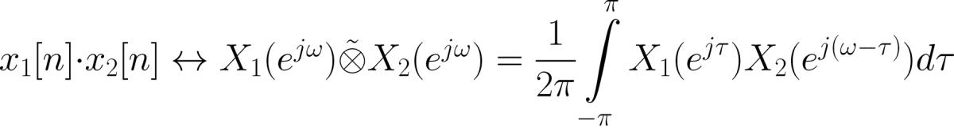

(6.17)
which is analogous to (2.24) for continuous-time LTI
systems
8. Multiplication
Multiplication in the time domain corresponds to convolution
in the frequency domain:
(6.18)
where denotes convolution within one period
Y.Chen
Page 27
Semester A, 2022-2023

Slide 28
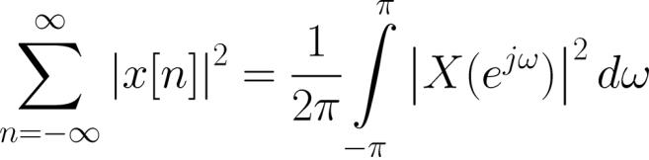
9. Parseval’s Relation
The Parseval’s relation addresses the energy of a sequence:
(6.19)
With the use of (6.2), the proof is:
Y.Chen
Page 28
Semester A, 2022-2023

Slide 29
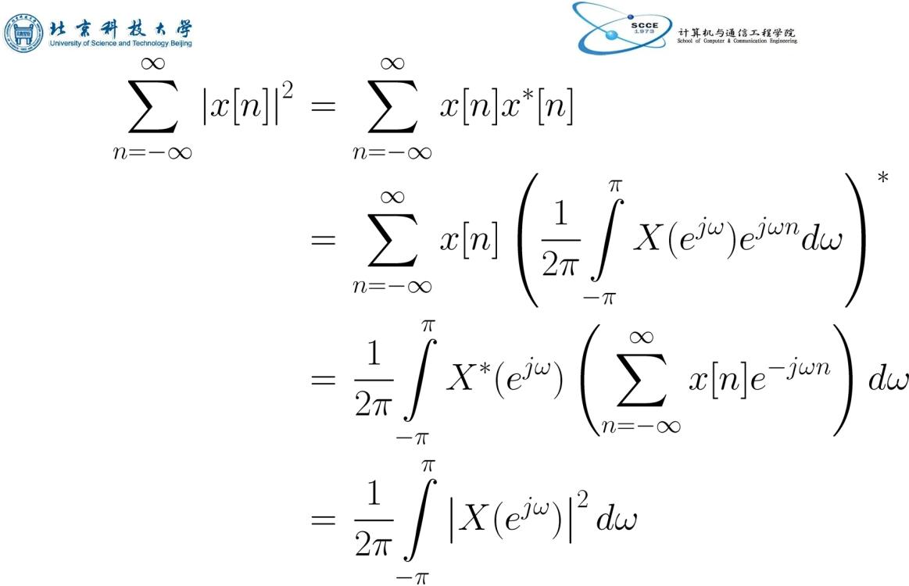
(6.20)
Y.Chen
Page 29
Semester A, 2022-2023

